Slide 1
Unfinished and finished actions
Present Perfect simple vs. Present perfect continuous

Slide 2
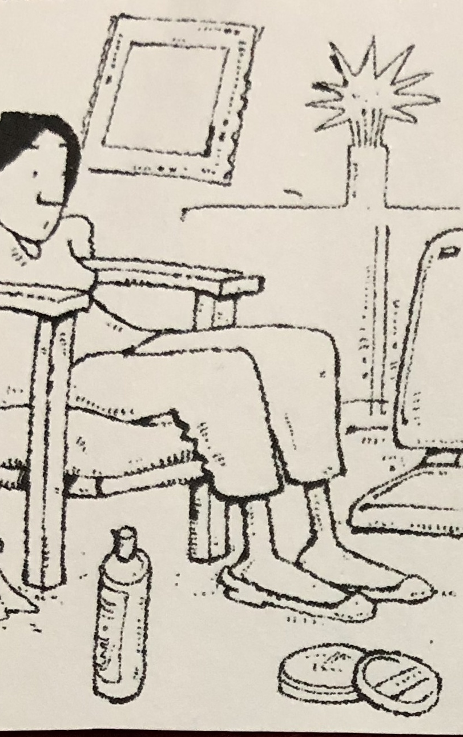
clean
She has been cleaning the living room.

Slide 3
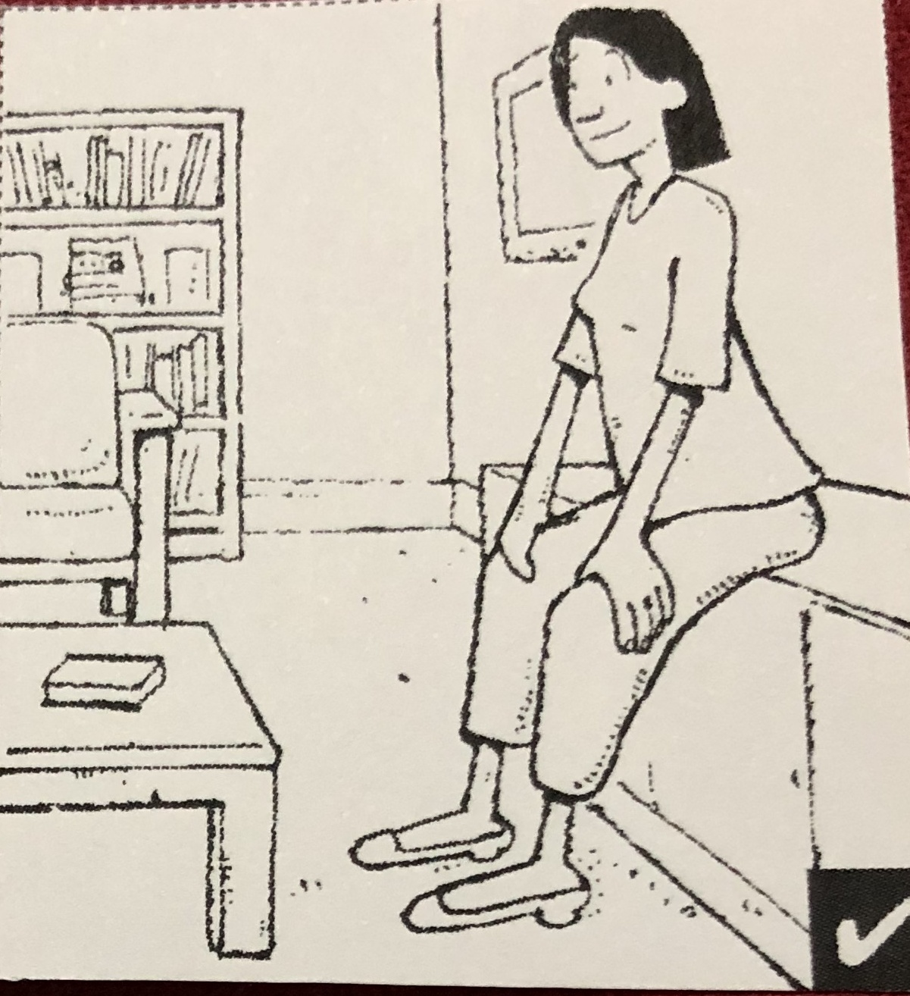
clean
She has cleaned the living room.

Slide 4
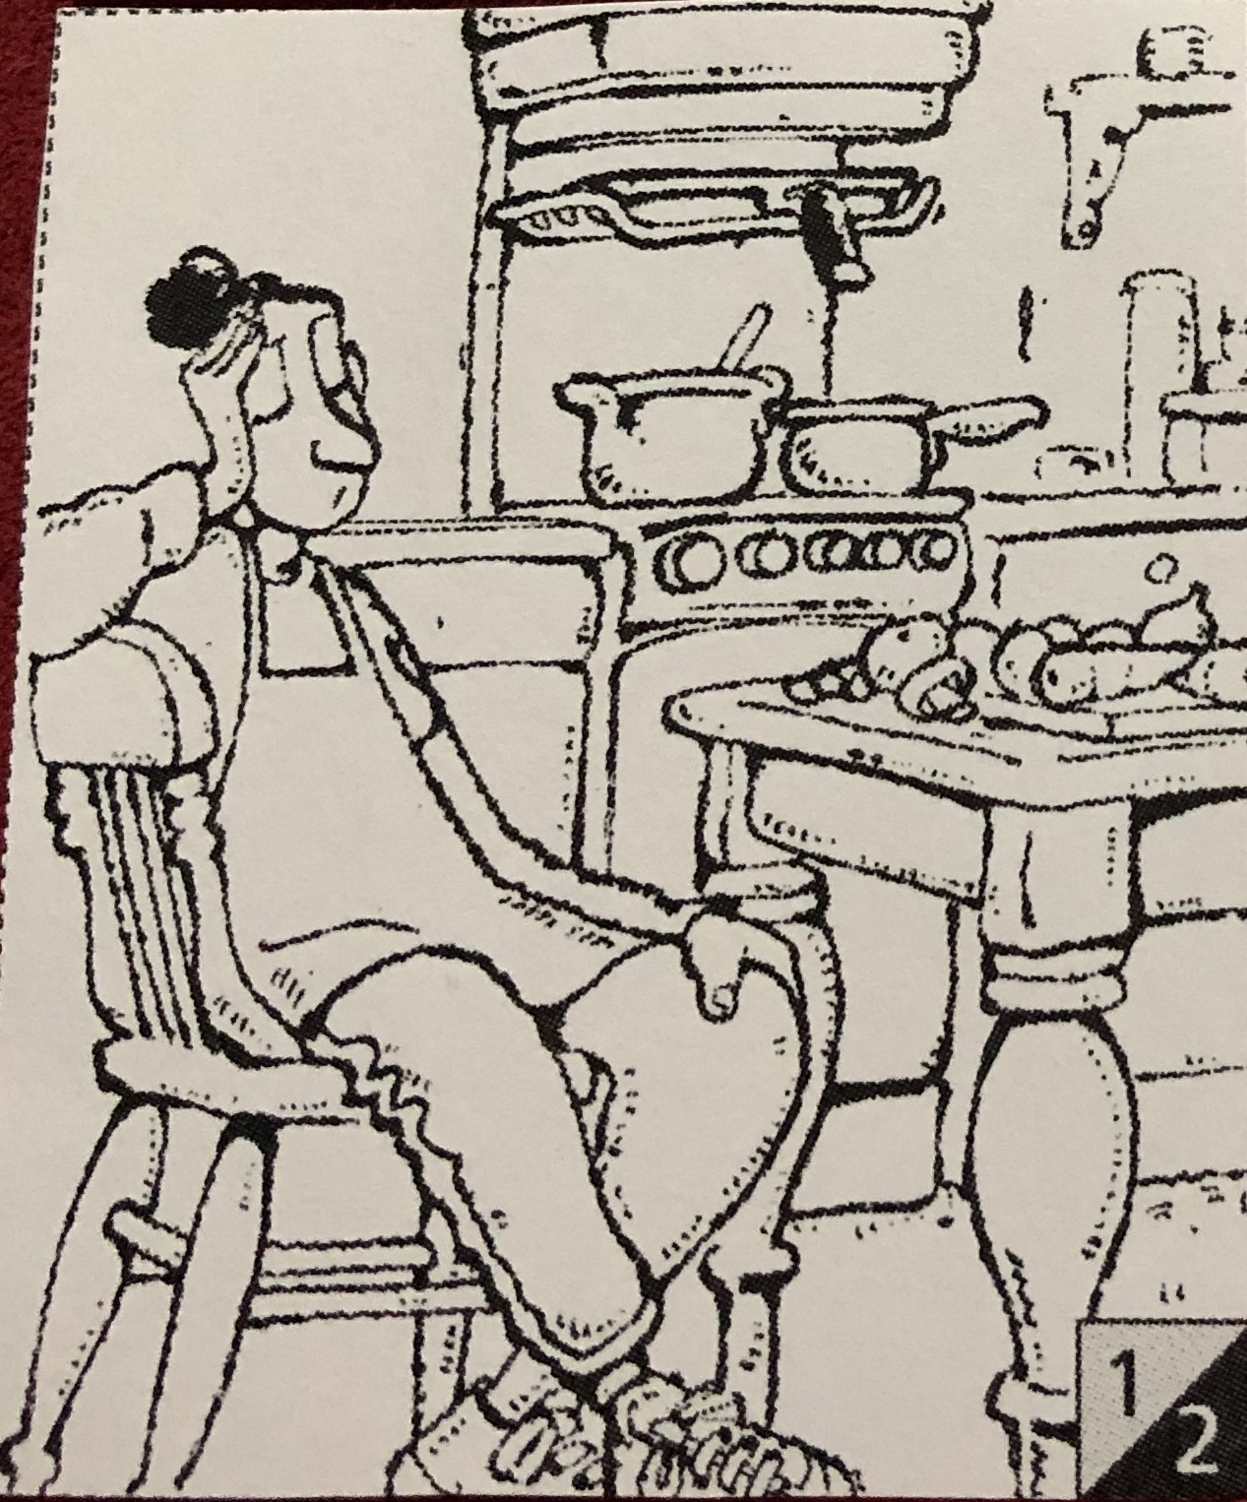
Cook
She has been cooking lunch (stew).

Slide 5
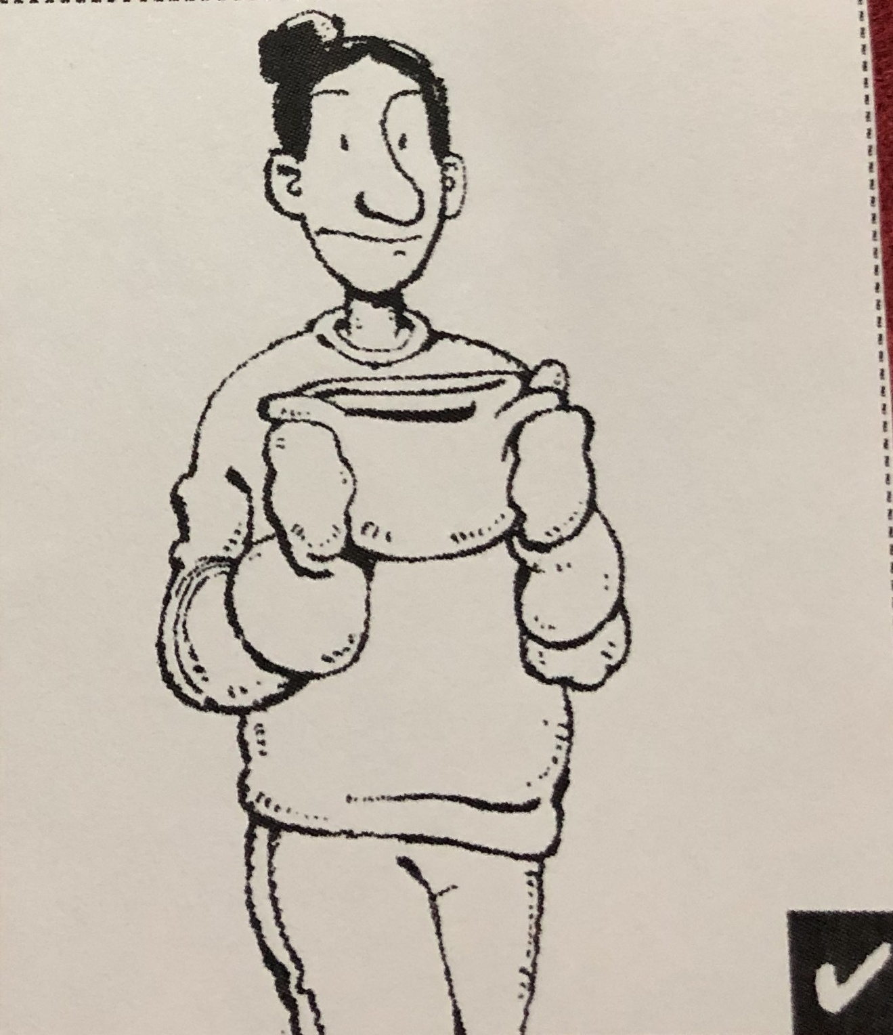
cook
She’s cooked the stew.

Slide 6
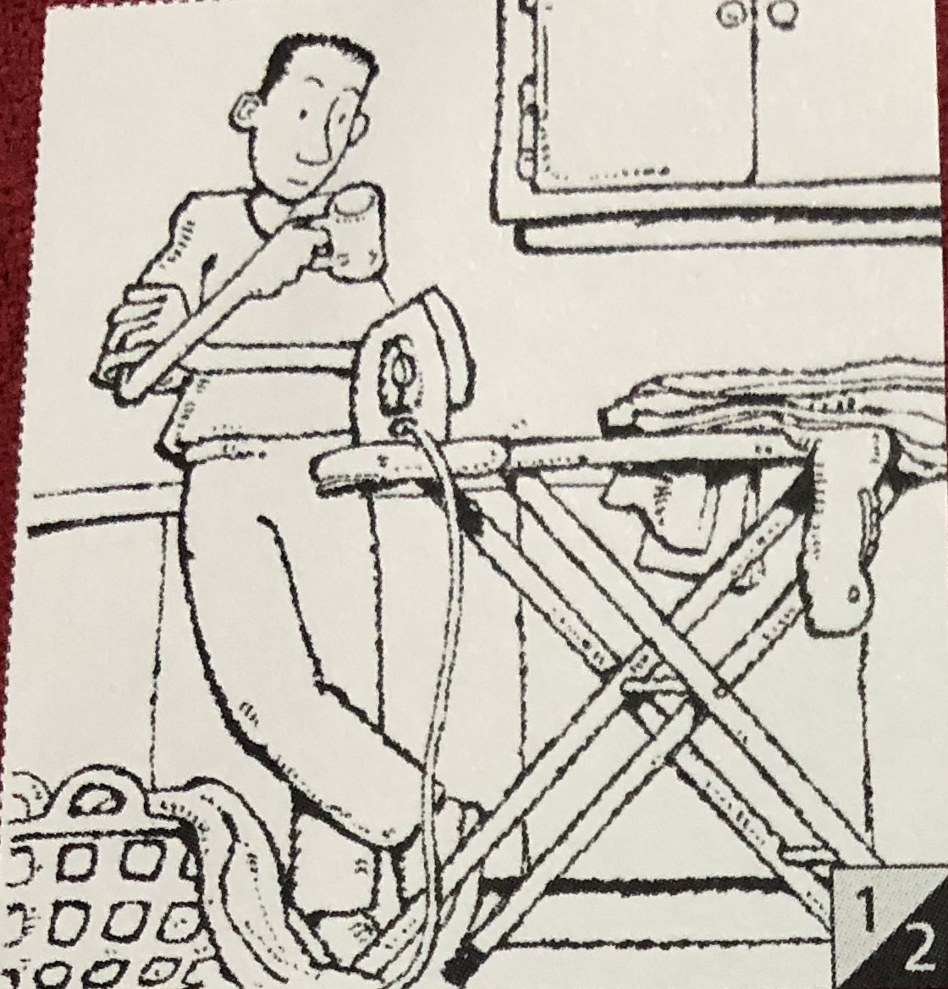
iron
He’s been ironing his shirts.

Slide 7
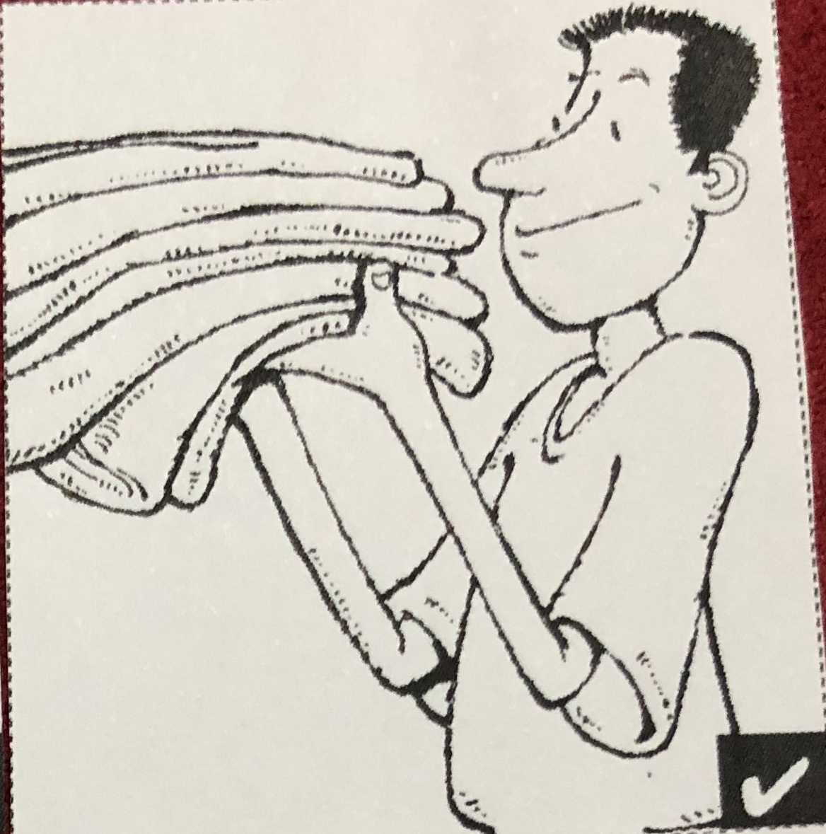
iron
He’s ironed his shirts.

Slide 8
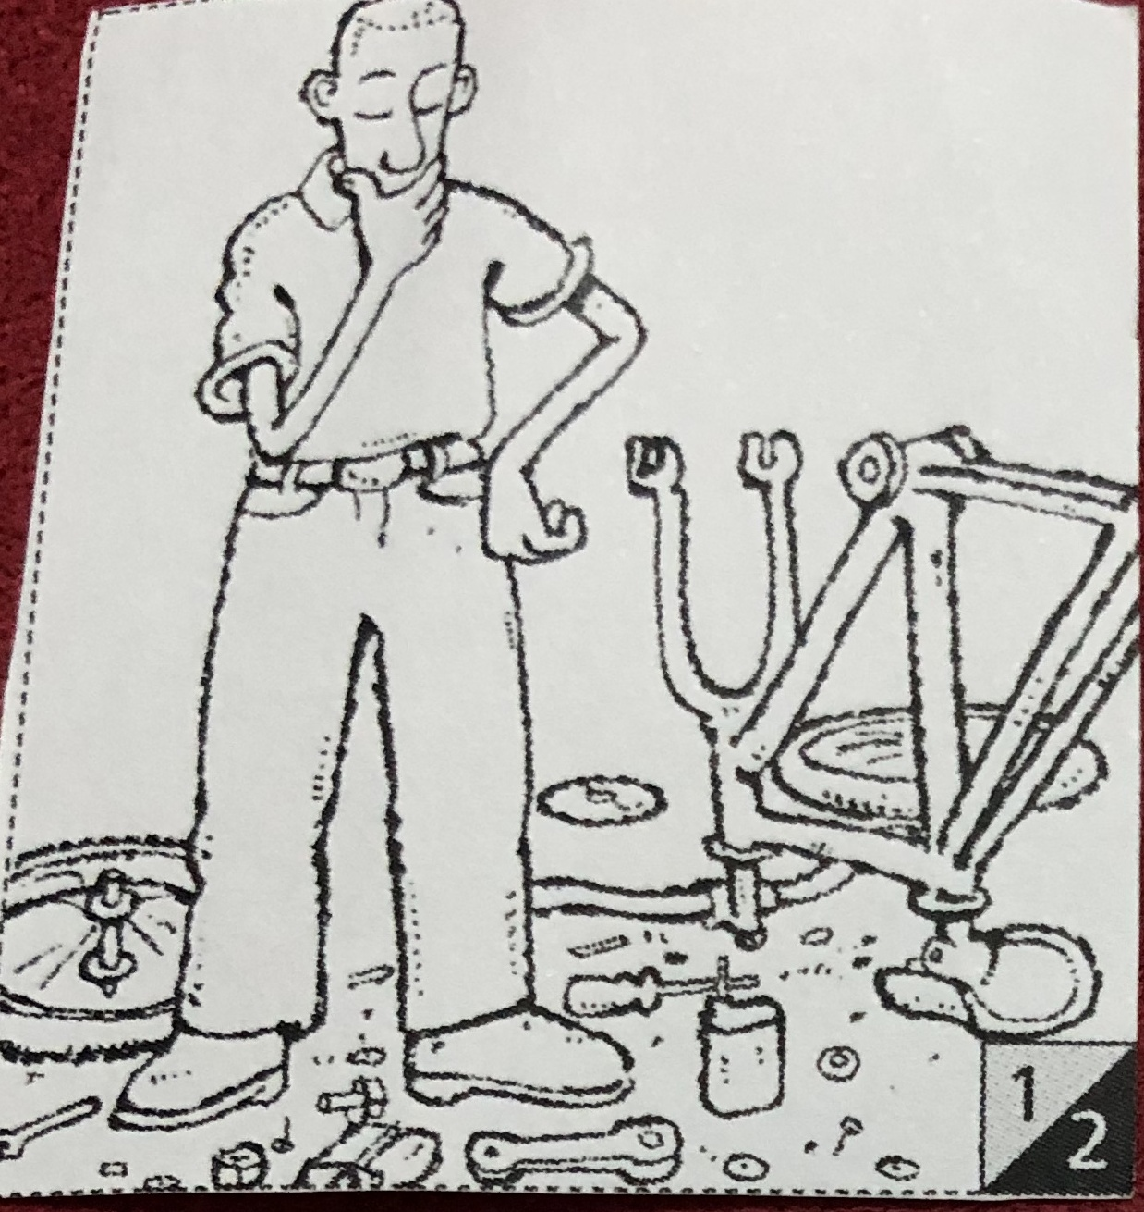
repair
He’s been repairing his bike.

Slide 9
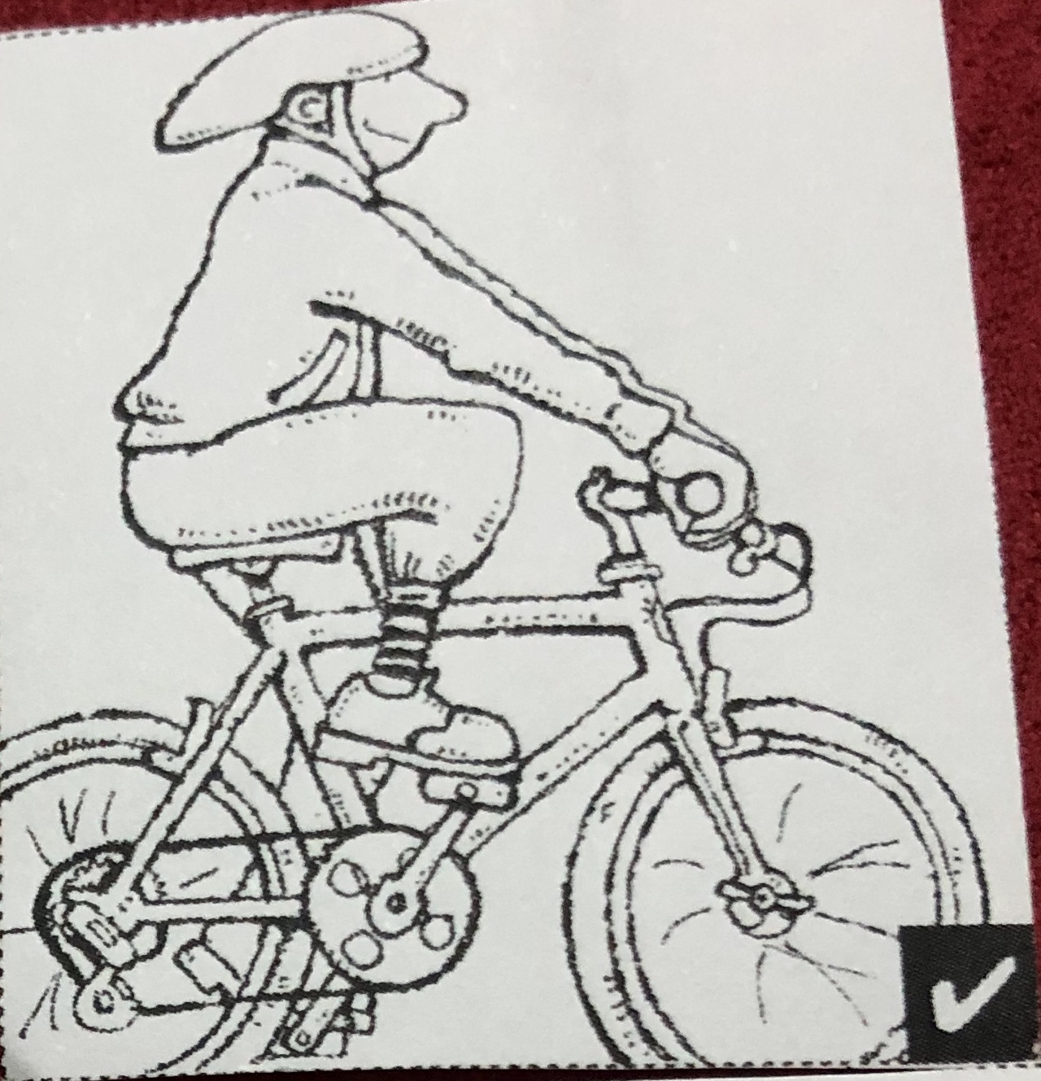
repair
He’s repaired his bike.

Slide 10
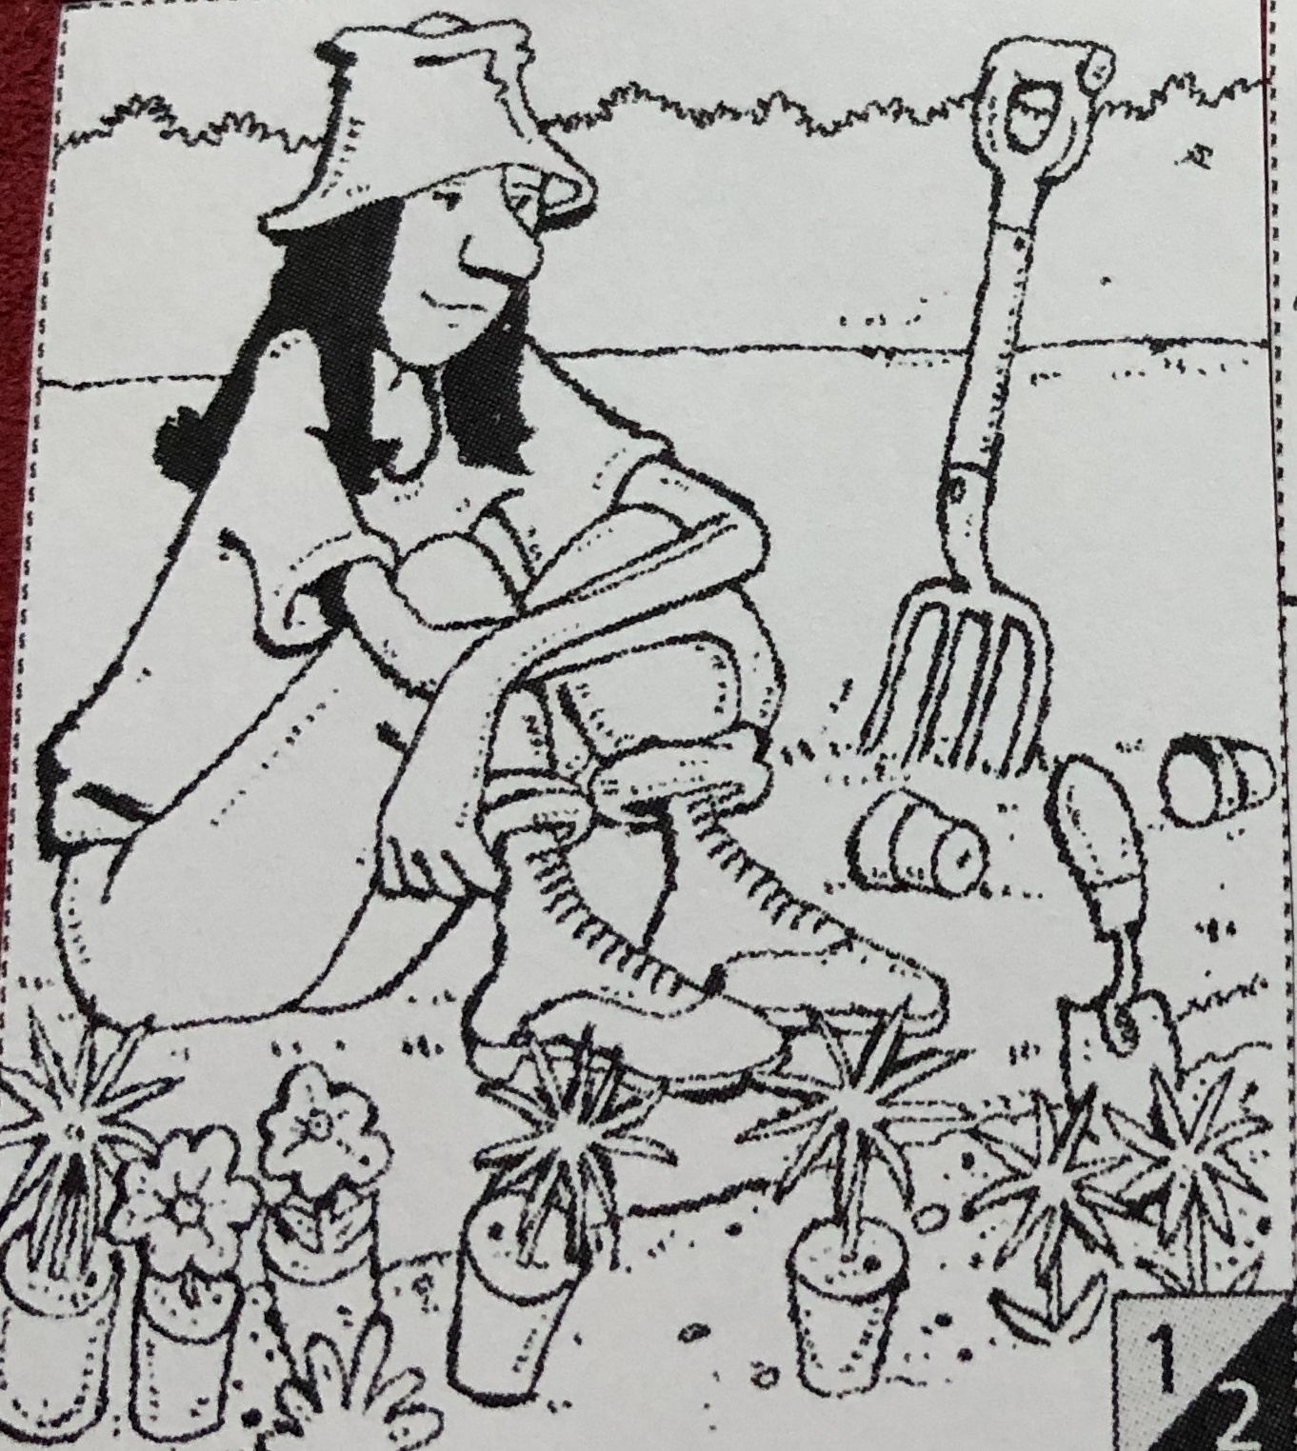
plant
sHe’s been planting some flowers and plants.

Slide 11
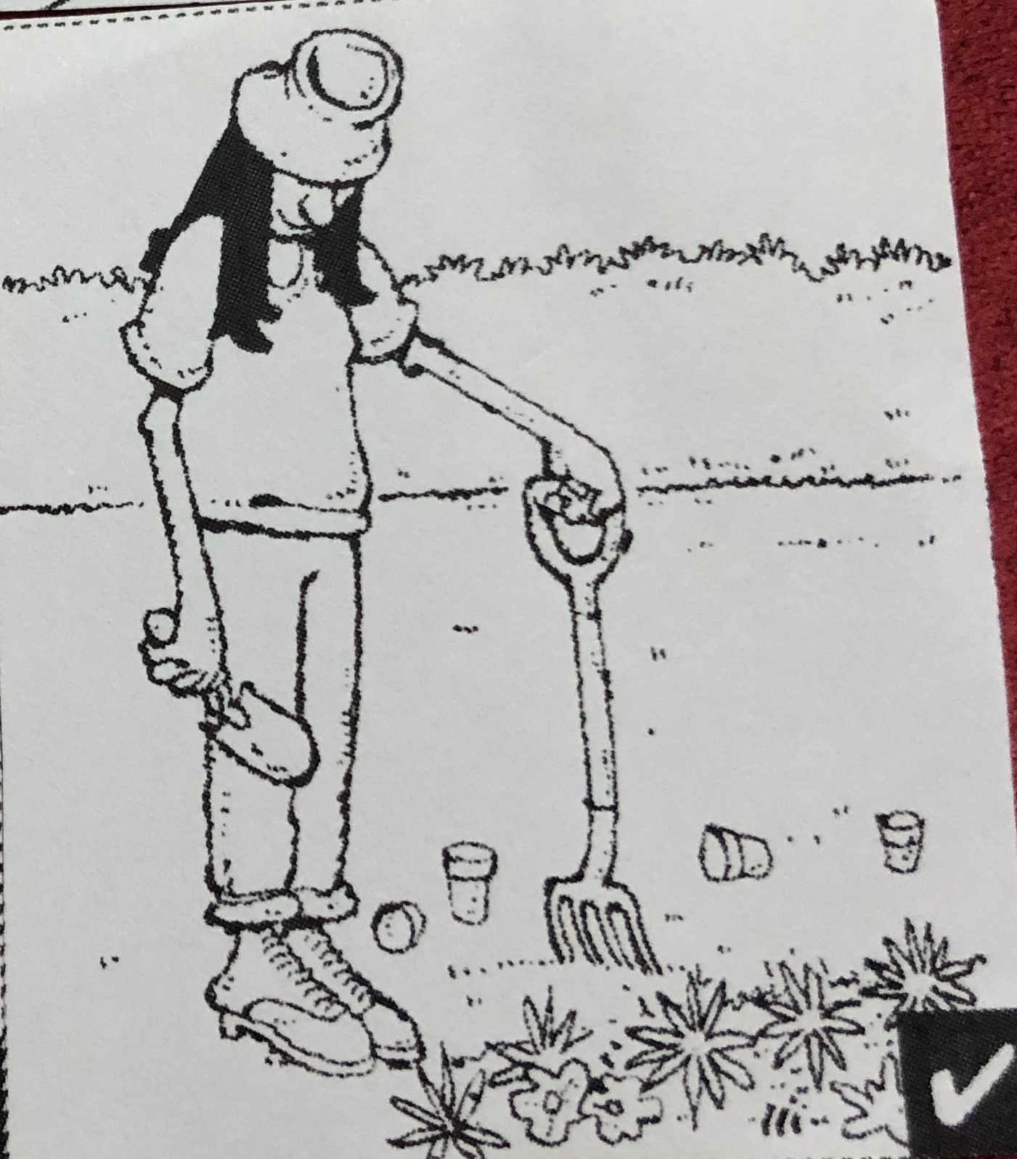
plant
sHe’s planted some flowers and plants.

Slide 12
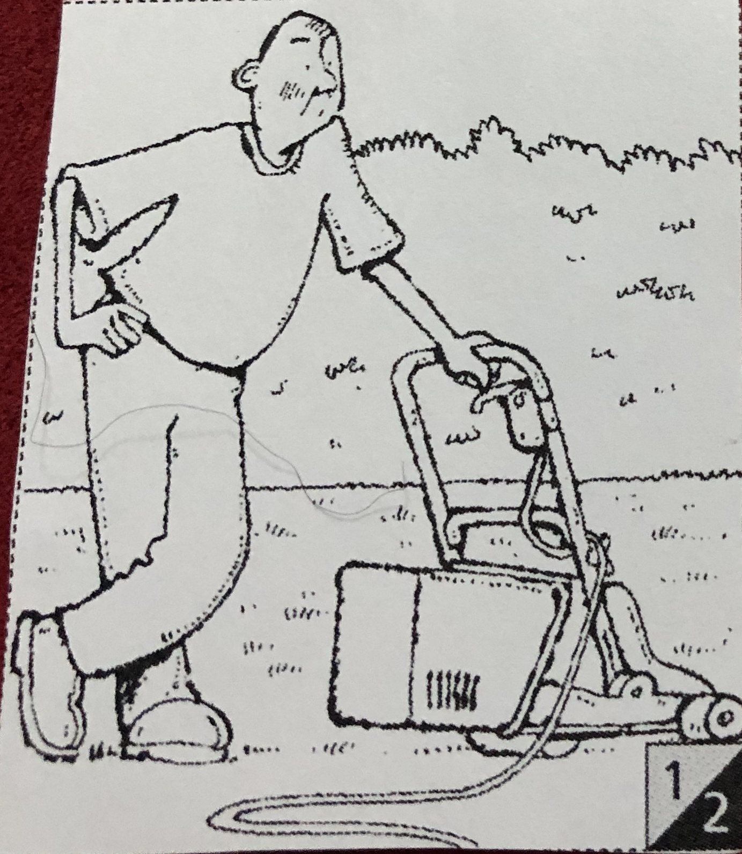
mow
He’s been mowing the lawn.

Slide 13
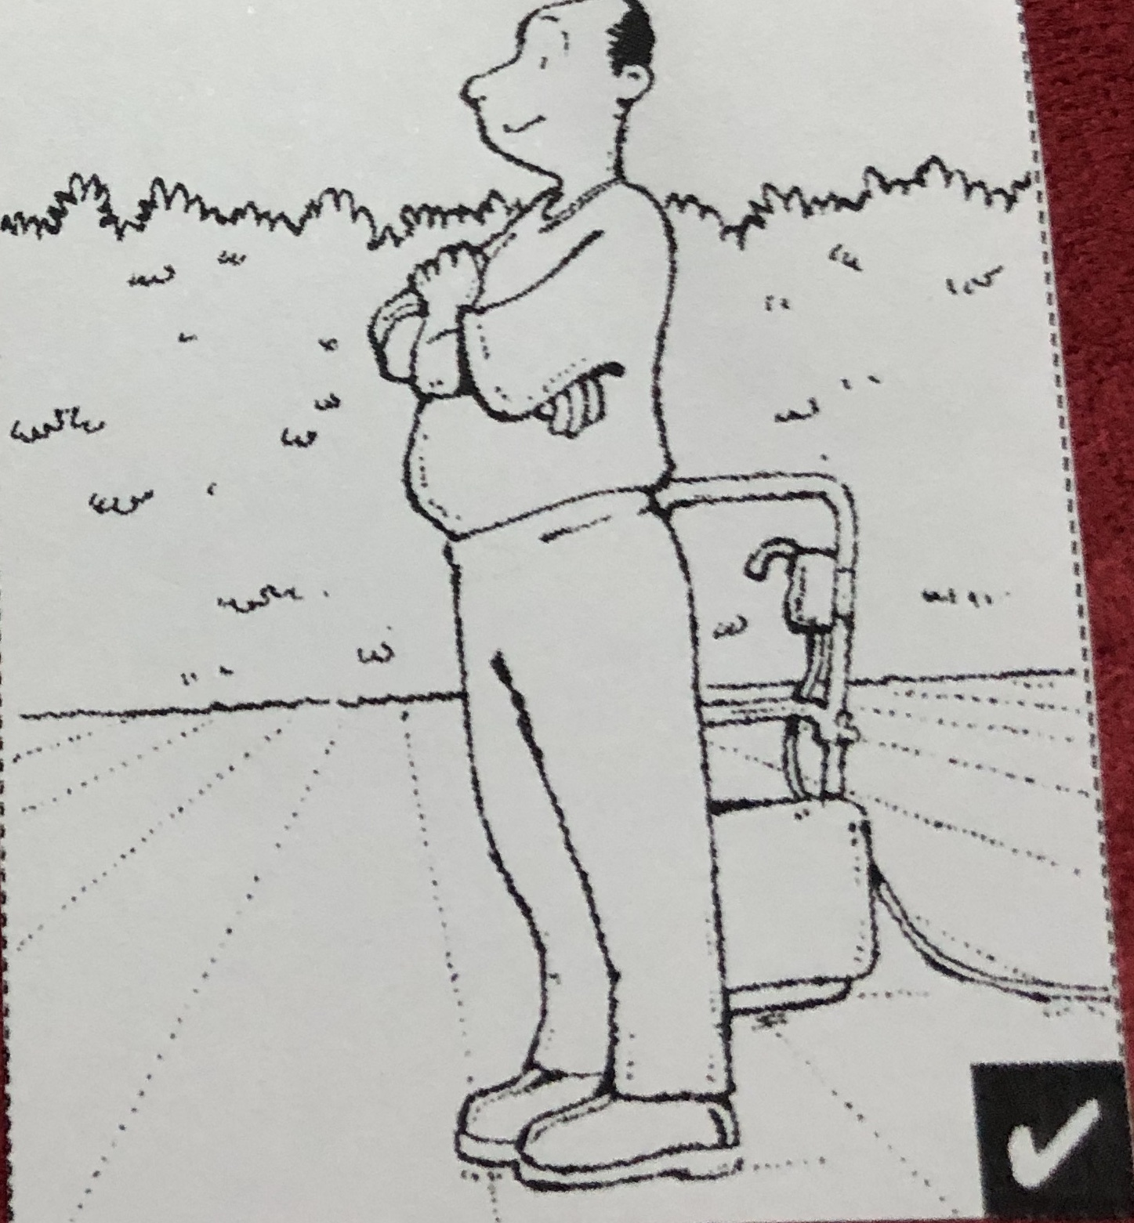
mow
He’s mowed the lawn.

Slide 14
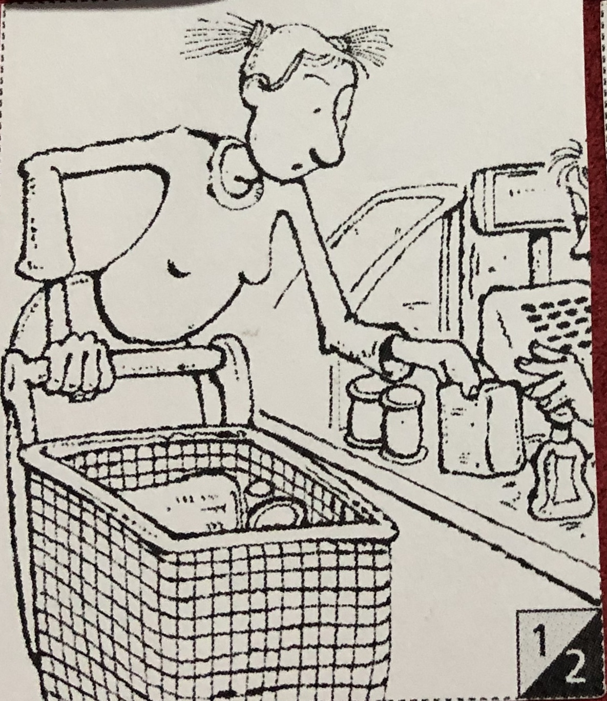
Do the shopping
sHe’s been doing the shopping.

Slide 15
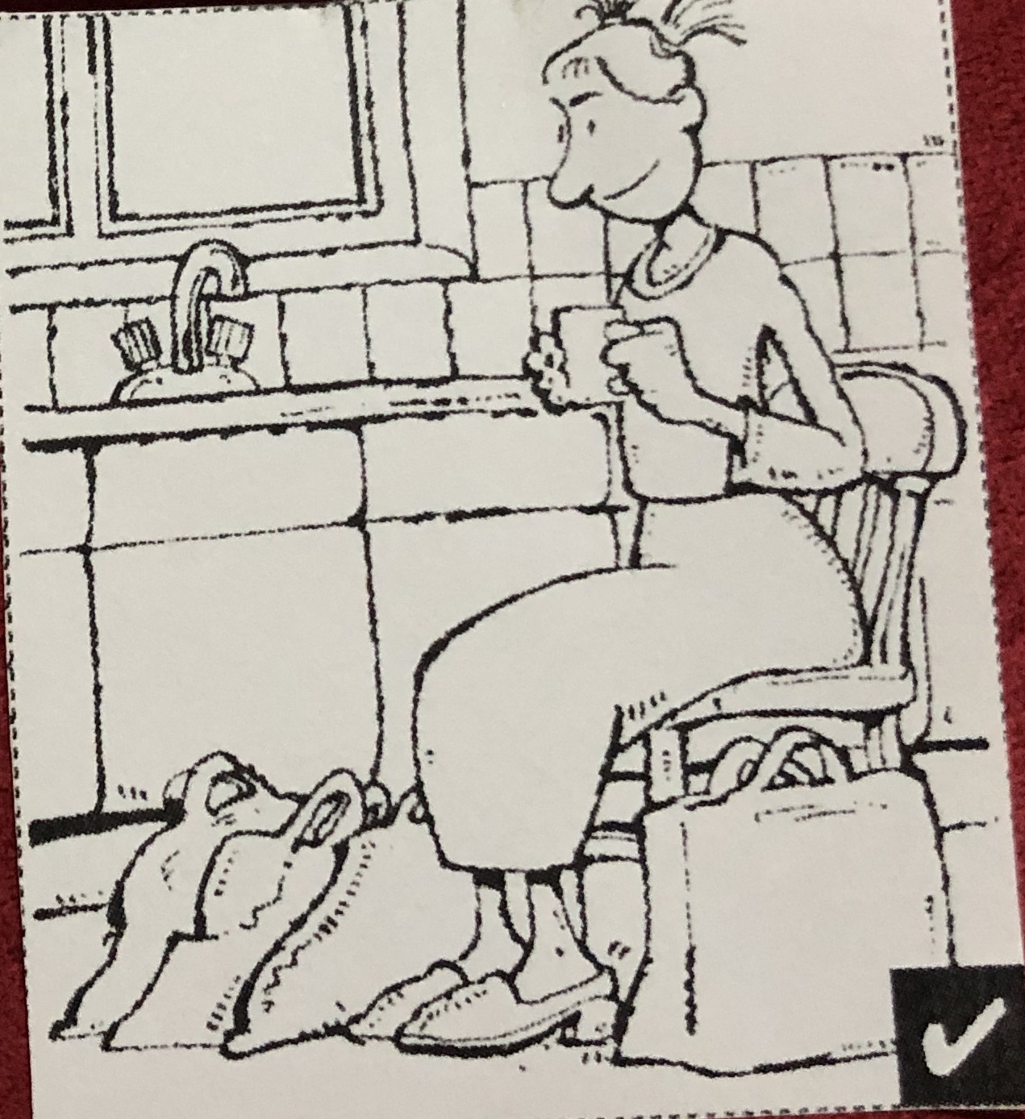
Do the shopping
sHe’s done the shopping.

Slide 16
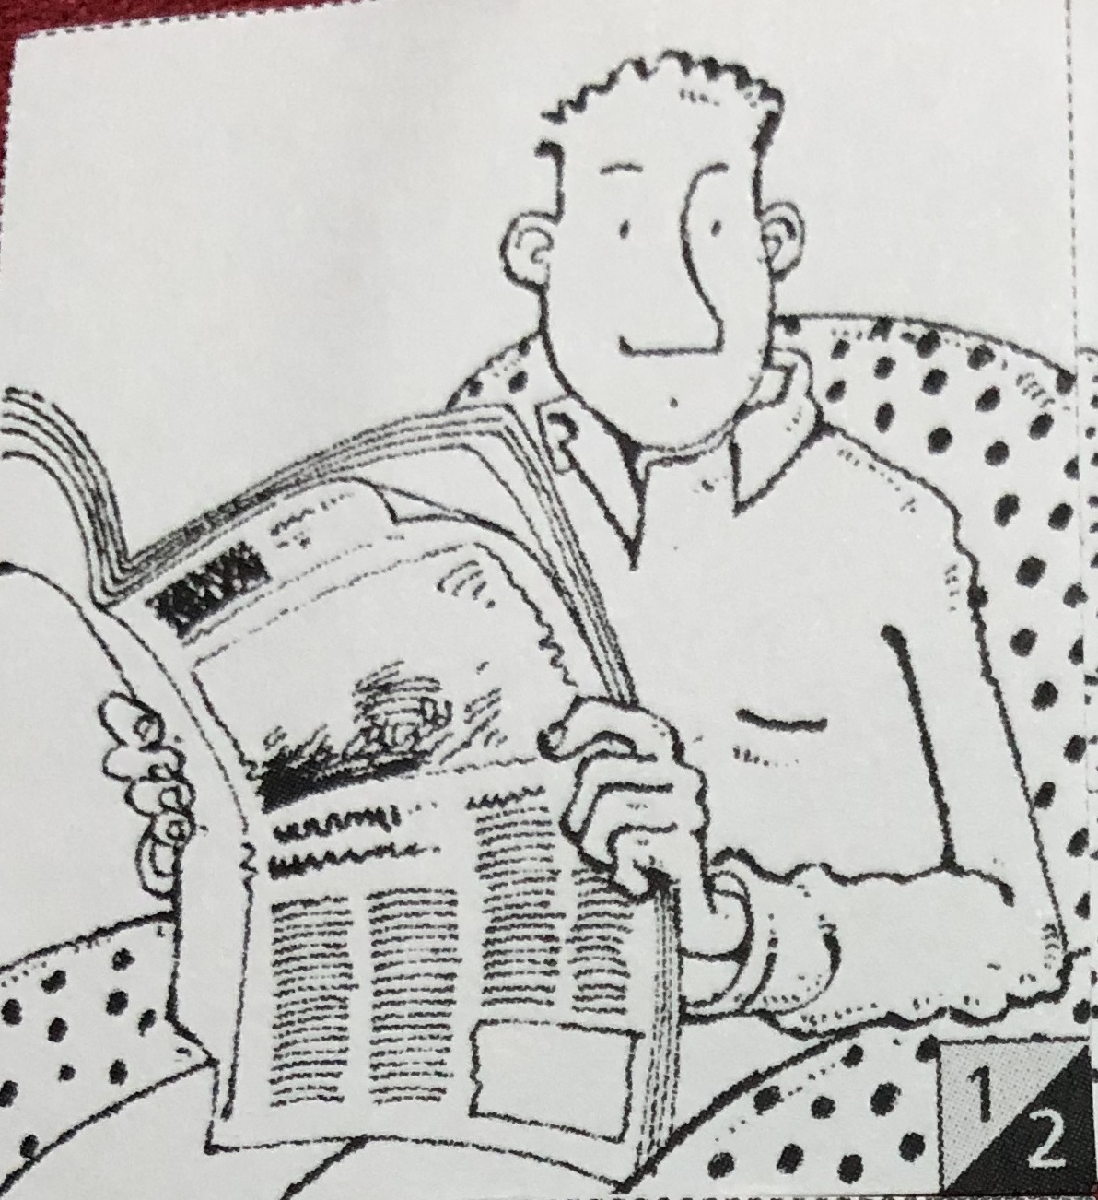
read
He’s been reading the newspaper.

Slide 17
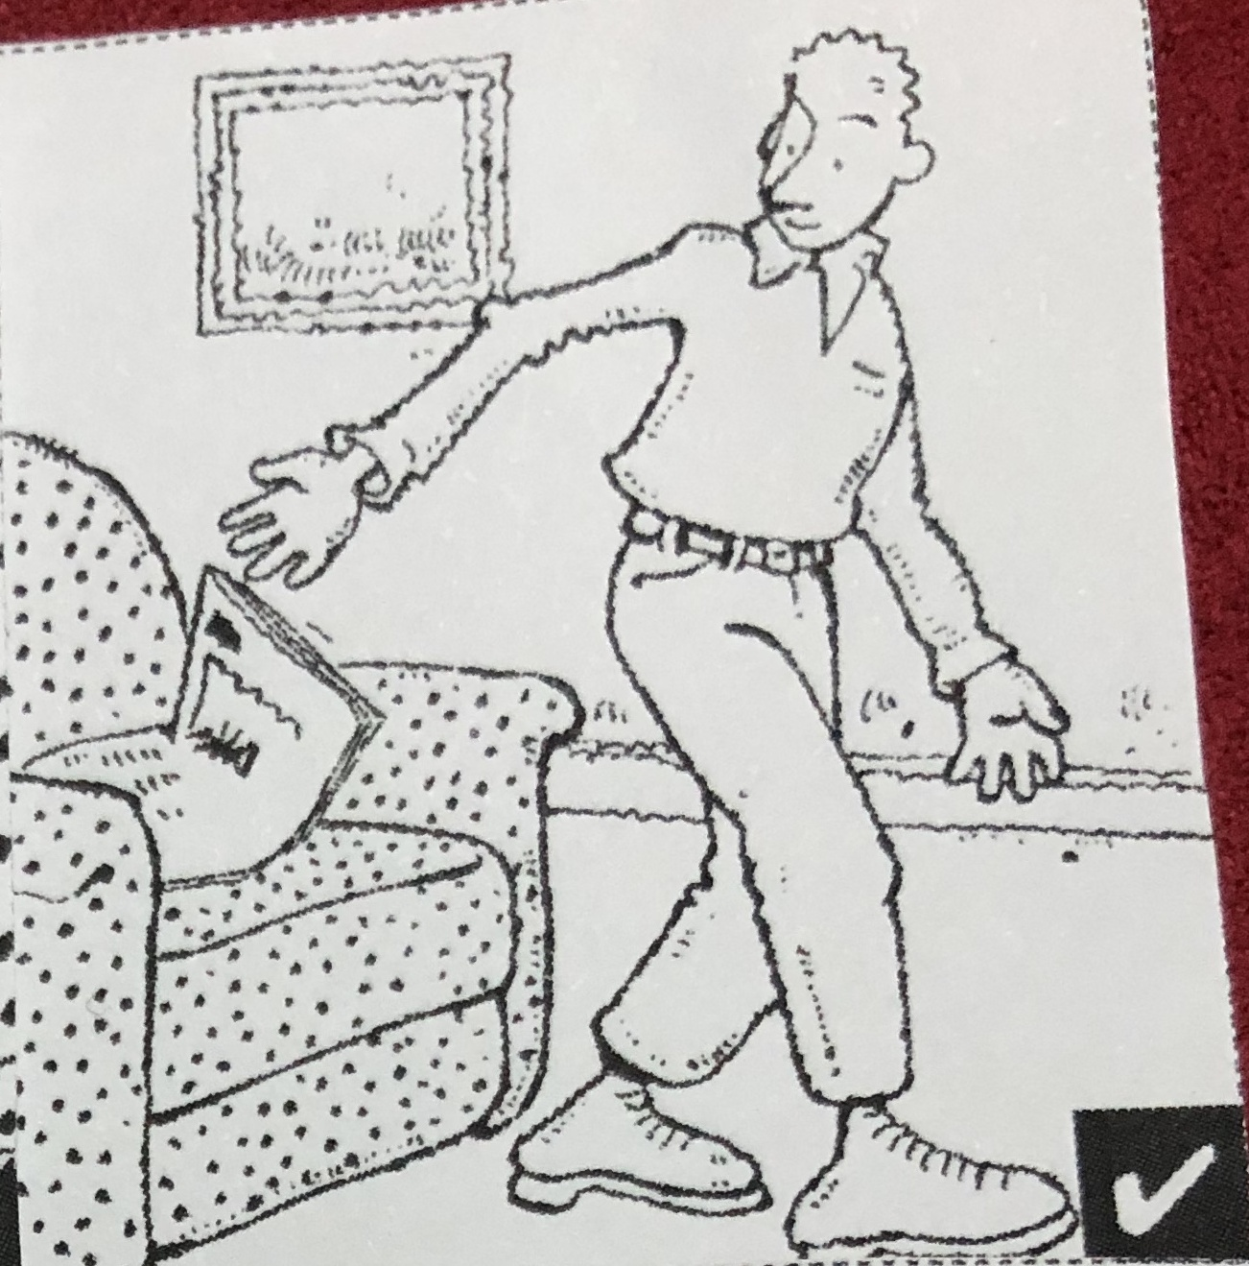
read
He’s read the newspaper.

